Slide 1

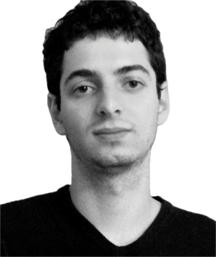
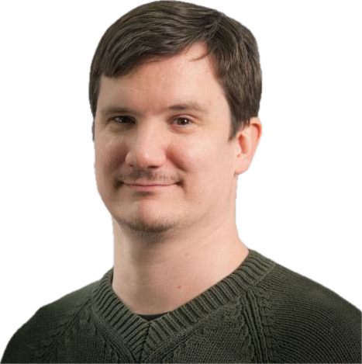
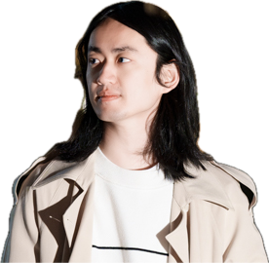
A Theory for Polynomial Time Approximate Counting
Lijie Chen
(University of Berkeley)
Jiatu Li
(MIT)
Igor C. Oliveira
(University of Warwick)
R. Ryan Williams
(MIT)

Slide 2
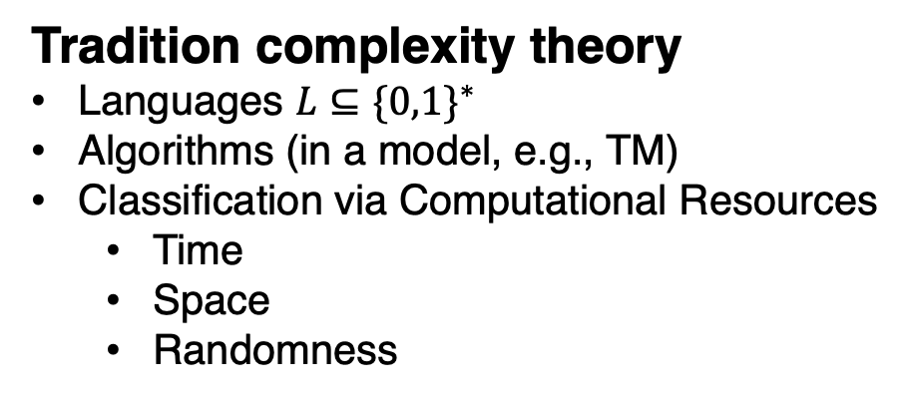
Background: Complexity of Mathematical Proofs
Tradition complexity theory
Languages $L⊆\{0,1\}^{∗}$
Algorithms (in a model, e.g., TM)
Classification via Computational Resources
  Time
  Space
  Randomness
A new “resource”: simple proof of correctness
What is a “simple” proof?
Why do we care about “simple” proofs?

Slide 3
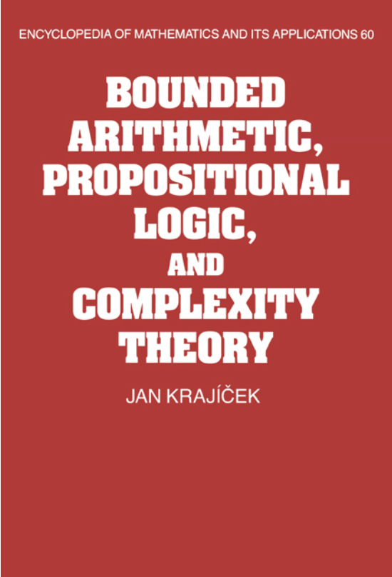
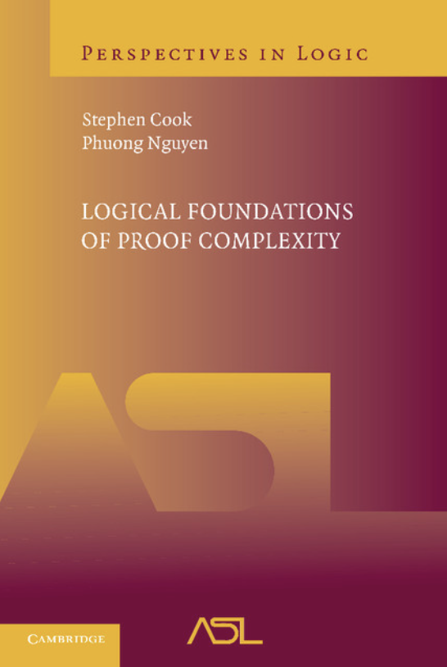
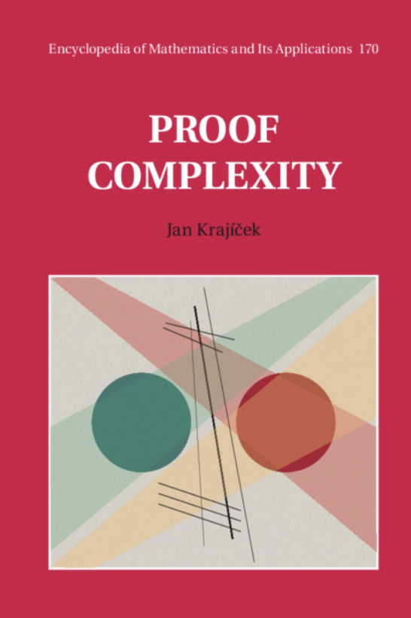
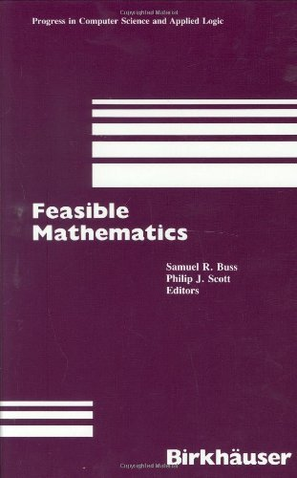
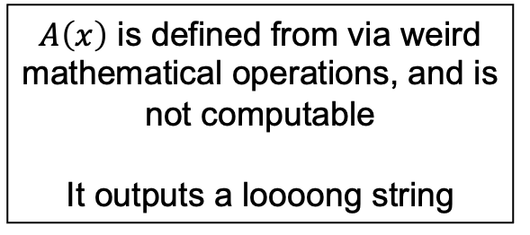
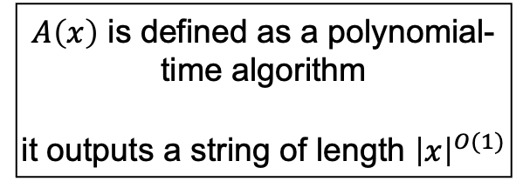
Background: Complexity of Proofs
A new “resource”: simple proof of correctness
What is a “simple” proof?
Why do we care about “simple” proofs?
Infeasible
Cook’s theory PV
$A\left(x\right)$ is defined from via weird mathematical operations, and is not computable
It outputs a loooong string
$A\left(x\right)$ is defined as a polynomial-time algorithm
it outputs a string of length ${\left|x\right|}^{O(1)}$
and a lot other theories corresponding to other complexity classes
Feasible Proofs, or
Bounded Arithmetic

Slide 4
Background: Complexity of Proofs
A new “resource”: simple proof of correctness
What is a “simple” proof?
Why do we care about “simple” proofs?
Unprovability of Complexity Conjectures
Goal: Show that $𝒯⊬$ NP $≠$ P or $𝒯⊬$ NP = P, or for other conjectures
Bounded theories are “weakest possible theories” where it is nontrivial [PS21, LO23, ABM23, …]
Bounded theories formalizes a large portion of TCS, e.g., PV formalizes Dinur’s proof of the PCP theorem [Pich15].
Proof Complexity Based Cryptography

Slide 5
Background: Complexity of Proofs
A new “resource”: simple proof of correctness
What is a “simple” proof?
Why do we care about “simple” proofs?
Unprovability of Complexity Conjectures
Proof Complexity Based Cryptography
(Upper Bounds): Jain and Jin (2022) – cryptographic primitives with “PV proof of correctness” is useful [JKLV24, JKLM25]
(Lower Bounds): Unprovability assumptions have been used to construct cryptographic primitives: Ilango [Ila25], and [HJLM26].

Slide 6

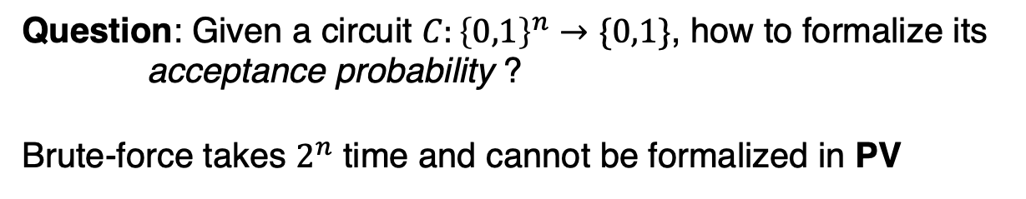
Motivation: Limitation of Existing Theories
PV: a theory where we play with only poly-time functions
Probabilistic methods
Question: Given a circuit $C:{\left\{0,1\right\}}^{n}→\{0,1\}$, how to formalize its
acceptance probability ?
Brute-force takes $2^{n}$ time and cannot be formalized in PV
Formalizing cryptographic assumptions
…
Not about “proof power”, but about formalization (language)

Slide 7

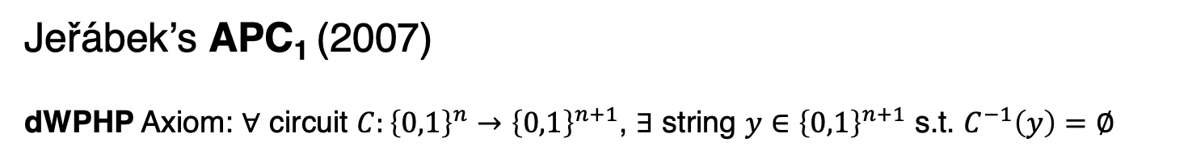
Motivation: Limitation of Existing Theories
PV: a theory where we play with only poly-time functions
Question: Given a circuit $C:{\left\{0,1\right\}}^{n}→\{0,1\}$, how to formalize its
acceptance probability ?
Jeřábek’s APC₁ (2007)
dWPHP Axiom: $∀$ circuit $C:{\left\{0,1\right\}}^{n}→{\left\{0,1\right\}}^{n+1}$, $∃$ string $y∈{\left\{0,1\right\}}^{n+1}$ s.t. $C^{−1}\left(y\right)=∅$
dWPHP
Jeřábek’s Magic
Formalize approximate counting
$∀1^{N} ∃$ a truth table of length $N$ that requires $N^{0.1}$-size circuit to compute
Nisan-Wigderson PRG to formalize (approximate) acceptance prob.
Formalization: NEXP $⊆$ PCP(poly, 1) [Pich 15], $⊕ ∉{AC}^{0}$ [MP20], Schwartz-Zippel [AT25], …

Slide 8
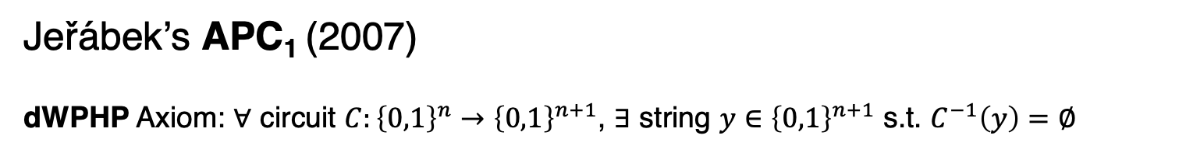
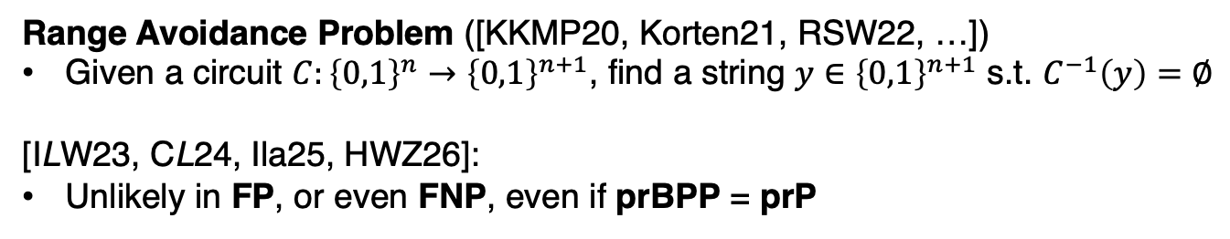
Motivation: Limitation of Existing Theories
PV: a theory where we play with only poly-time functions
Question: Given a circuit $C:{\left\{0,1\right\}}^{n}→\{0,1\}$, how to formalize its
acceptance probability ?
Jeřábek’s APC₁ (2007)
dWPHP Axiom: $∀$ circuit $C:{\left\{0,1\right\}}^{n}→{\left\{0,1\right\}}^{n+1}$, $∃$ string $y∈{\left\{0,1\right\}}^{n+1}$ s.t. $C^{−1}\left(y\right)=∅$
Formalize approximate counting
Range Avoidance Problem ([KKMP20, Korten21, RSW22, …])
Given a circuit $C:{\left\{0,1\right\}}^{n}→{\left\{0,1\right\}}^{n+1}$, find a string $y∈{\left\{0,1\right\}}^{n+1}$ s.t. $C^{−1}\left(y\right)=∅$
[ILW23, CL24, Ila25, HWZ26]:
Unlikely in FP, or even FNP, even if prBPP = prP
dWPHP itself is a strong combinatorial principle

Slide 9
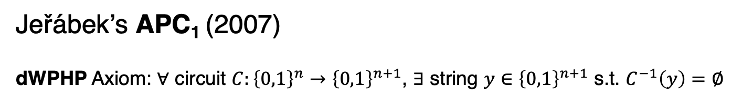
Motivation: Limitation of Existing Theories
dWPHP
PV: a theory where we play with only poly-time functions
Question: Given a circuit $C:{\left\{0,1\right\}}^{n}→\{0,1\}$, how to formalize its
acceptance probability ?
Jeřábek’s APC₁ (2007)
dWPHP Axiom: $∀$ circuit $C:{\left\{0,1\right\}}^{n}→{\left\{0,1\right\}}^{n+1}$, $∃$ string $y∈{\left\{0,1\right\}}^{n+1}$ s.t. $C^{−1}\left(y\right)=∅$
APC₁
???
Formalize approximate counting
There should be a theory that is between PV and APC₁ that better characterizes “the minimal theory for poly-time approximate counting”.
dWPHP itself is a strong combinatorial principle
Notes:
Expose more fine-grained structure for:
Unprovability results are easier (compared to APC₁)
Weaker unprovability assumptions for cryptography
More applications to be discovered!

Slide 10

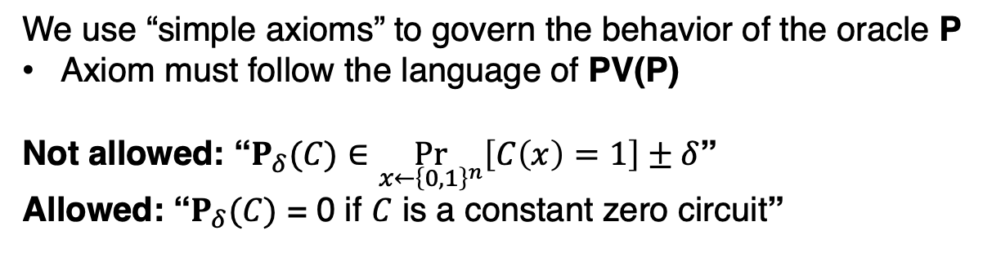
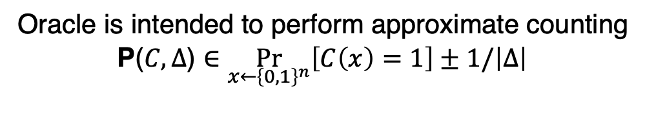

Our Results: A New Theory for Probabilistic Poly Time
This Work: A new theory APX₁ that extends PV with basic probabilistic capability, while weaker than APC₁.
P($C,Δ$)
Oracle is intended to perform approximate counting
P($C,Δ$) $∈\underset{x←{\left\{0,1\right\}}^{n}}{Pr}\left[C\left(x\right)=1\right]±1/\left|Δ\right|$
polynomial-time algorithm with an oracle
For simplicity, $P_{δ}\left(C\right)≔P\left(C,1^{δ^{−1}}\right)$
We use “simple axioms” to govern the behavior of the oracle P
Axiom must follow the language of PV(P)
Not allowed: “$P_{δ}(C)$ $∈\underset{x←{\left\{0,1\right\}}^{n}}{Pr}\left[C\left(x\right)=1\right]±δ$”
Allowed: “$P_{δ}(C)$ = 0 if $C$ is a constant zero circuit”

Slide 11

Our Results: A New Theory for Probabilistic Poly Time
This Work: A new theory APX₁ that extends PV with basic probabilistic capability, while weaker than APC₁.
P($C,Δ$)
😅
polynomial-time algorithm with an oracle
It is not even clear whether a good “microscope” exists for TCS
- axiomatization for (approx.) probability

Slide 12

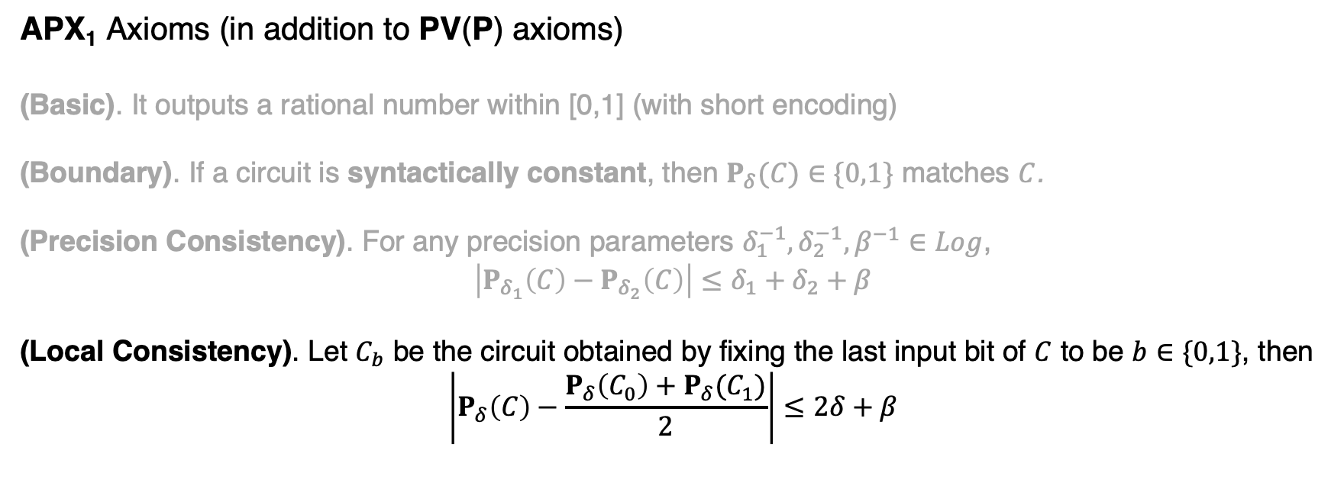
Our Results: A New Theory for Probabilistic Poly Time
P($C,Δ$)
This Work: A new theory APX₁ that extends PV with basic probabilistic capability, while weaker than APC₁.
polynomial-time algorithm with an oracle
APX₁ Axioms (in addition to PV(P) axioms)
(Basic). It outputs a rational number within [0,1] (with short encoding)
(Boundary). If a circuit is syntactically constant, then $P_{δ}(C)$ $∈\{0,1\}$ matches $C$.
(Precision Consistency). For any precision parameters $δ_{1}^{−1},δ_{2}^{−1},β^{−1}∈Log$,
$$\left|P_{δ_{1}}\left(C\right)−P_{δ_{2}}\left(C\right)\right|≤δ_{1}+δ_{2}+β$$
(Local Consistency). Let $C_{b}$ be the circuit obtained by fixing the last input bit of $C$ to be $b∈\{0,1\}$, then
$$\left|P_{δ}\left(C\right)−\frac{P_{δ}\left(C_{0}\right)+P_{δ}(C_{1})}{2}\right|≤2δ+β$$

Slide 13

Our Results: A New Theory for Probabilistic Poly Time
This Work: A new theory APX₁ that extends PV with basic probabilistic capability, while weaker than APC₁.
Message 1: APX₁ is not a toy theory: it’s strong enough to carry out real TCS.
It formalizes a large chunk of elementary probability theory
It formalizes interesting TCS
Yao’s lemma
Distinguisher $→$ Predictor
Schwartz-Zippel
(via [AT25])
Blum-Luby-Rubinfeld
Linearity Testing
Average-case Lower Bound
against AC⁰

Slide 14
Our Results: A New Theory for Probabilistic Poly Time
This Work: A new theory APX₁ that extends PV with basic probabilistic capability, while weaker than APC₁.
Message 1: APX₁ is not a toy theory: it’s strong enough to carry out real TCS.
Message 2: PV $⊆$ APX₁ $⊊$ APC₁ (separation is conditional)
APX₁ is “weaker” than APC₁: we can implement P oracle using
Nisan-Wigderson PRG, and all axioms are provable (implicit in Jeřábek’s work)
Jeřábek’s Magic
APX₁ cannot prove dWPHP assuming iO and NP $≠$ coNP, by adapting [ILW23] that separates PV₁ and dWPHP.

Slide 15
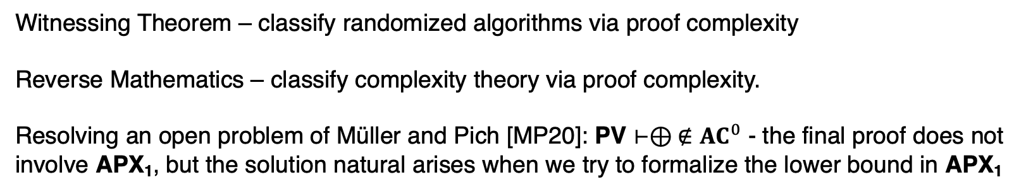
Our Results: A New Theory for Probabilistic Poly Time
This Work: A new theory APX₁ that extends PV with basic probabilistic capability, while weaker than APC₁.
Message 1: APX₁ is not a toy theory: it’s strong enough to carry out real TCS.
Message 2: PV $⊆$ APX₁ $⊊$ APC₁ (separation is conditional)
Other Results and Messages:
Witnessing Theorem – classify randomized algorithms via proof complexity
Reverse Mathematics – classify complexity theory via proof complexity.
Resolving an open problem of Müller and Pich [MP20]: PV $⊢⊕ ∉{AC}^{0}$ - the final proof does not involve APX₁, but the solution natural arises when we try to formalize the lower bound in APX₁

Slide 16
Open Problems
Formalization of other parts of TCS
  Can we formalize security of cryptographic primitives?
  SNARGs for NP from Unprovability of Mathematical Theorems. Hsieh, Jain, Li, Mathialagan in STOC 26 --- APC₁ is used, can we use APX₁ instead?
Can we separate PV and APX₁?
  In other words, can we derandomize “feasible proofs”…?
Interesting connection to propositional proof complexity?
  What interesting things can we say about it?

Slide 17
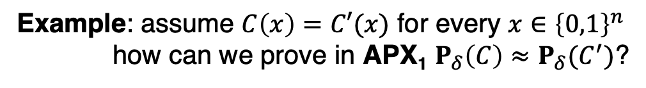
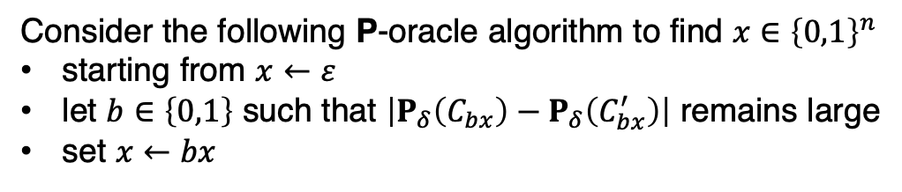
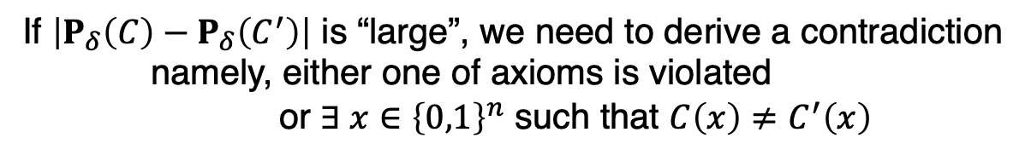
Key Idea: Pointwise-to-Global Technique
Example: assume $C\left(x\right)=C′(x)$ for every $x∈{\left\{0,1\right\}}^{n}$
how can we prove in APX₁ $P_{δ}\left(C\right)≈P_{δ}(C^{′})$?
P($C,Δ$)
If $\left|P_{δ}\left(C\right)−P_{δ}\left(C^{′}\right)\right|$ is “large”, we need to derive a contradiction
namely, either one of axioms is violated
or $∃ x∈{\left\{0,1\right\}}^{n}$ such that $C\left(x\right)≠C^{′}\left(x\right)$
polynomial-time algorithm with an oracle
Let $C_{x}$ be the circuit $C$ after fixing the last $|x|$ bits to be $x$
Consider the following P-oracle algorithm to find $x∈{\left\{0,1\right\}}^{n}$
starting from $x←ε$
let $b∈\left\{0,1\right\}$ such that $\left|P_{δ}\left(C_{bx}\right)−P_{δ}\left(C_{bx}^{′}\right)\right|$ remains large
set $x←bx$

Slide 18

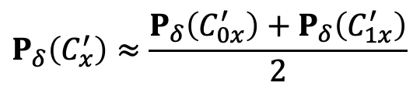

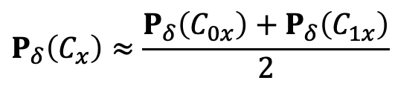




Key Idea: Pointwise-to-Global Technique
Example: assume $C\left(x\right)=C′(x)$ for every $x∈{\left\{0,1\right\}}^{n}$
how can we prove in APX₁ $P_{δ}\left(C\right)≈P_{δ}(C^{′})$?
P($C,Δ$)
If $\left|P_{δ}\left(C\right)−P_{δ}\left(C^{′}\right)\right|$ is “large”, we need to derive a contradiction
namely, either one of axioms is violated
or $∃ x∈{\left\{0,1\right\}}^{n}$ such that $C\left(x\right)≠C^{′}\left(x\right)$
polynomial-time algorithm with an oracle
$\left|P_{δ}\left(C\right)−P_{δ}\left(C^{′}\right)\right|$ is “large”
Claim 1: We can always fix a bit so the gap remains large.
$\left|P_{δ}\left(C_{b_{1}}\right)−P_{δ}\left(C_{b_{1}}^{′}\right)\right|$ is “large”
$$P_{δ}\left(C_{x}\right)≈\frac{P_{δ}\left(C_{0x}\right)+P_{δ}\left(C_{1x}\right)}{2}$$
$\left|P_{δ}\left(C_{b_{2}b_{1}}\right)−P_{δ}\left(C_{b_{2}b_{1}}^{′}\right)\right|$ is “large”
(by local consistency)
$$⋮$$
$$P_{δ}\left(C_{x}^{′}\right)≈\frac{P_{δ}\left(C_{0x}^{′}\right)+P_{δ}\left(C_{1x}^{′}\right)}{2}$$
$\left|P_{δ}\left(C_{{b_{n}…b}_{2}b_{1}}\right)−P_{δ}\left(C_{{b_{n}…b}_{2}b_{1}}^{′}\right)\right|$ is “large”

Slide 19
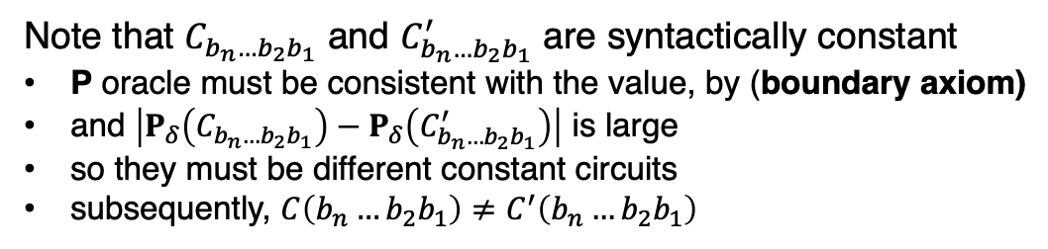
Key Idea: Pointwise-to-Global Technique
Example: assume $C\left(x\right)=C′(x)$ for every $x∈{\left\{0,1\right\}}^{n}$
how can we prove in APX₁ $P_{δ}\left(C\right)≈P_{δ}(C^{′})$?
P($C,Δ$)
If $\left|P_{δ}\left(C\right)−P_{δ}\left(C^{′}\right)\right|$ is “large”, we need to derive a contradiction
namely, either one of axioms is violated
or $∃ x∈{\left\{0,1\right\}}^{n}$ such that $C\left(x\right)≠C^{′}\left(x\right)$
polynomial-time algorithm with an oracle
$\left|P_{δ}\left(C\right)−P_{δ}\left(C^{′}\right)\right|$ is “large”
Claim 1: We can always fix a bit so the gap remains large.
$\left|P_{δ}\left(C_{b_{1}}\right)−P_{δ}\left(C_{b_{1}}^{′}\right)\right|$ is “large”
Claim 2: In the end, $C\left(b_{n}…b_{2}b_{1}\right)≠C^{′}\left(b_{n}…b_{2}b_{1}\right)$
$\left|P_{δ}\left(C_{b_{2}b_{1}}\right)−P_{δ}\left(C_{b_{2}b_{1}}^{′}\right)\right|$ is “large”
Note that $C_{b_{n}…b_{2}b_{1}}$ and $C_{b_{n}…b_{2}b_{1}}^{′}$ are syntactically constant
P oracle must be consistent with the value, by (boundary axiom)
and $\left|P_{δ}\left(C_{{b_{n}…b}_{2}b_{1}}\right)−P_{δ}\left(C_{{b_{n}…b}_{2}b_{1}}^{′}\right)\right|$ is large
so they must be different constant circuits
subsequently, $C\left(b_{n}…b_{2}b_{1}\right)≠C^{′}\left(b_{n}…b_{2}b_{1}\right)$
$$⋮$$
$\left|P_{δ}\left(C_{{b_{n}…b}_{2}b_{1}}\right)−P_{δ}\left(C_{{b_{n}…b}_{2}b_{1}}^{′}\right)\right|$ is “large”

Slide 20

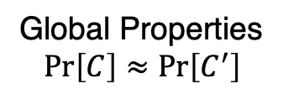
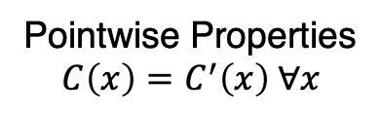
Key Idea: Pointwise-to-Global Technique
Example: assume $C\left(x\right)=C′(x)$ for every $x∈{\left\{0,1\right\}}^{n}$
how can we prove in APX₁ $P_{δ}\left(C\right)≈P_{δ}(C^{′})$?
P($C,Δ$)
If $\left|P_{δ}\left(C\right)−P_{δ}\left(C^{′}\right)\right|$ is “large”, we need to derive a contradiction
namely, either one of axioms is violated
or $∃ x∈{\left\{0,1\right\}}^{n}$ such that $C\left(x\right)≠C^{′}\left(x\right)$
polynomial-time algorithm with an oracle
$\left|P_{δ}\left(C\right)−P_{δ}\left(C^{′}\right)\right|$ is “large”
Claim 1: We can always fix a bit so the gap remains large.
$\left|P_{δ}\left(C_{b_{1}}\right)−P_{δ}\left(C_{b_{1}}^{′}\right)\right|$ is “large”
Claim 2: In the end, $C\left(b_{n}…b_{2}b_{1}\right)≠C^{′}\left(b_{n}…b_{2}b_{1}\right)$
$\left|P_{δ}\left(C_{b_{2}b_{1}}\right)−P_{δ}\left(C_{b_{2}b_{1}}^{′}\right)\right|$ is “large”
Pointwise Properties
$$C\left(x\right)=C^{′}\left(x\right) ∀x$$
$$⋮$$
$\left|P_{δ}\left(C_{{b_{n}…b}_{2}b_{1}}\right)−P_{δ}\left(C_{{b_{n}…b}_{2}b_{1}}^{′}\right)\right|$ is “large”
(APX₁ axioms)
Global Properties
$$\operatorname{Pr}\left[C\right]≈\operatorname{Pr}\left[C^{′}\right]$$

